Slide 1
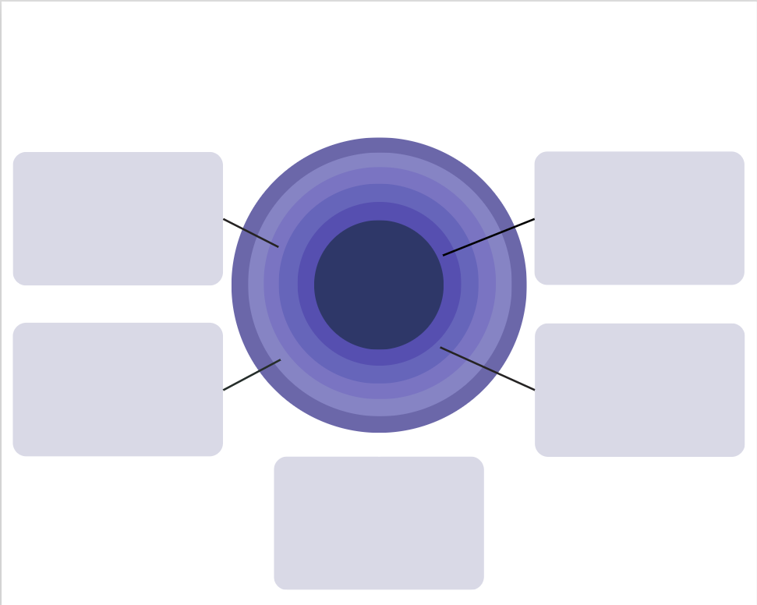


cut1
cut2
box3
box1
center_circle
box4
box2
box5

Slide 2


cut1
cut2
box3
box1
center_circle
box4
box2
box5

